Slide 1

Airline safety
Disha Saha
Executive Summary

Slide 2
Itinerary
Review the financials
Net Profit for US airlines
Total Operating Revenue for US Airlines
Total Operating Expense for US Airlines
US Average Domestic Round Trip Airfare
Review Safety Metrics
Major Airlines Fatalities
Major Airline Incidents
Concluding Remarks

Slide 3
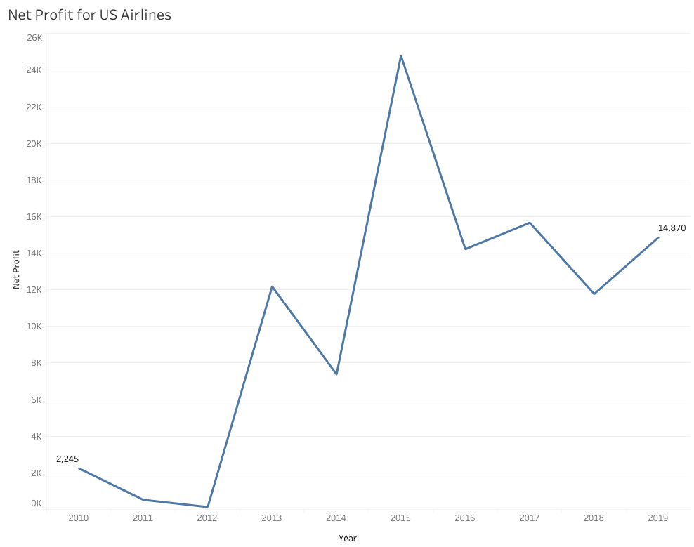
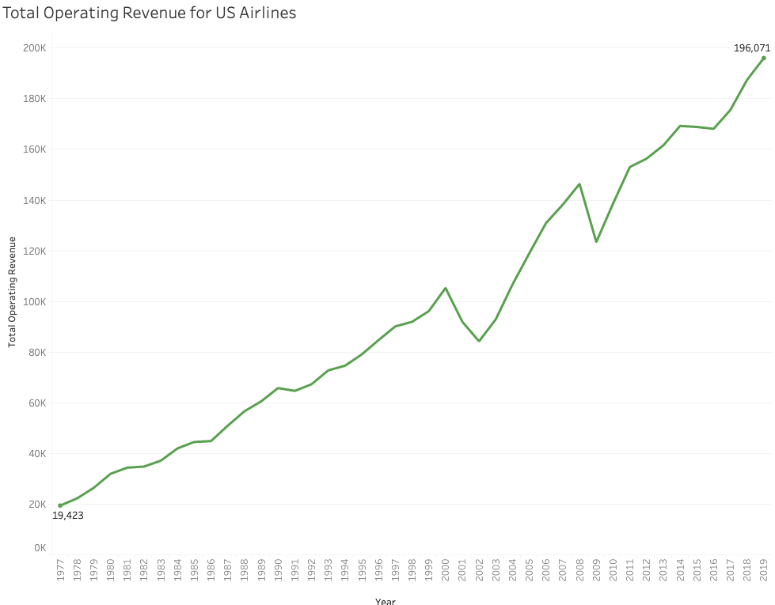
Net Profit for US Airlines

Slide 4
Total Operating Revenue for US Airlines

Slide 5
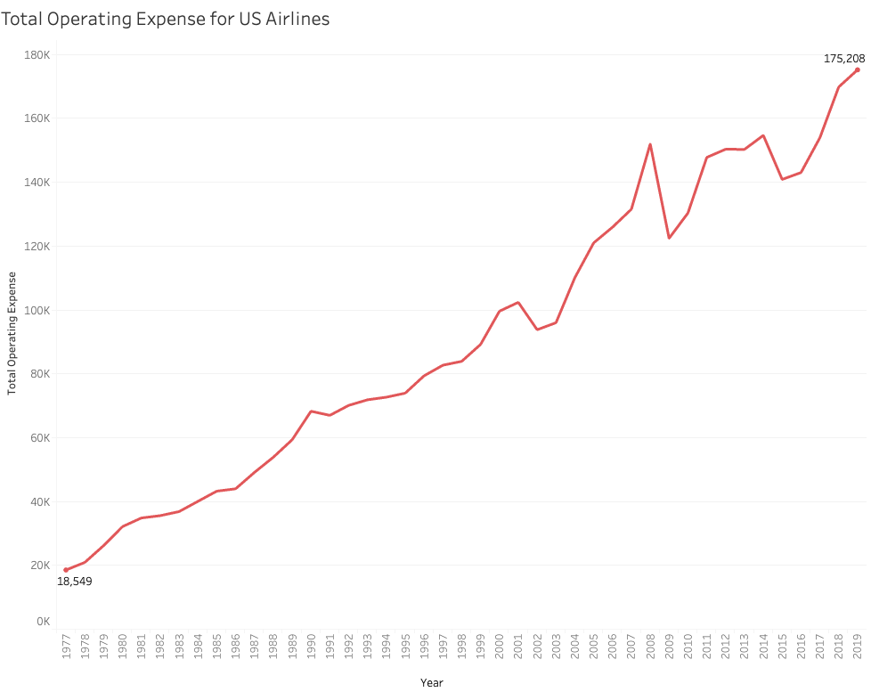
Total Operating Expense for US Airlines

Slide 6
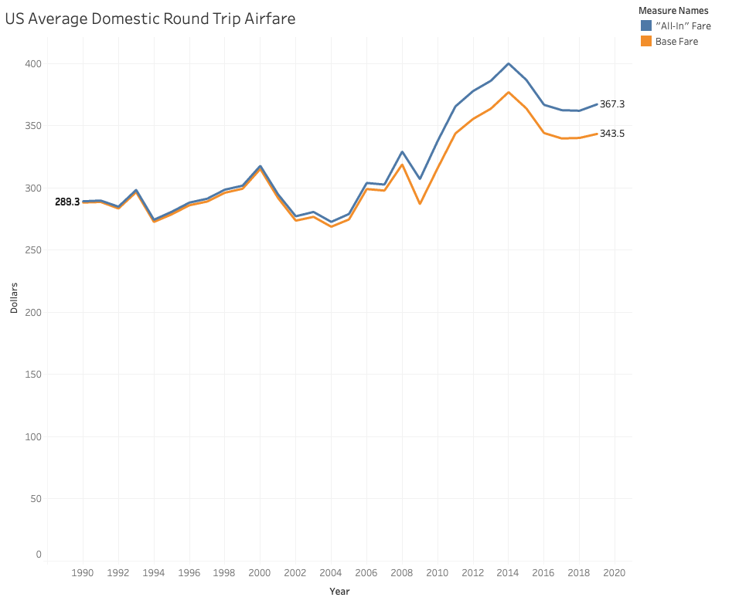
US Average Domestic Round Trip Airfare

Slide 7
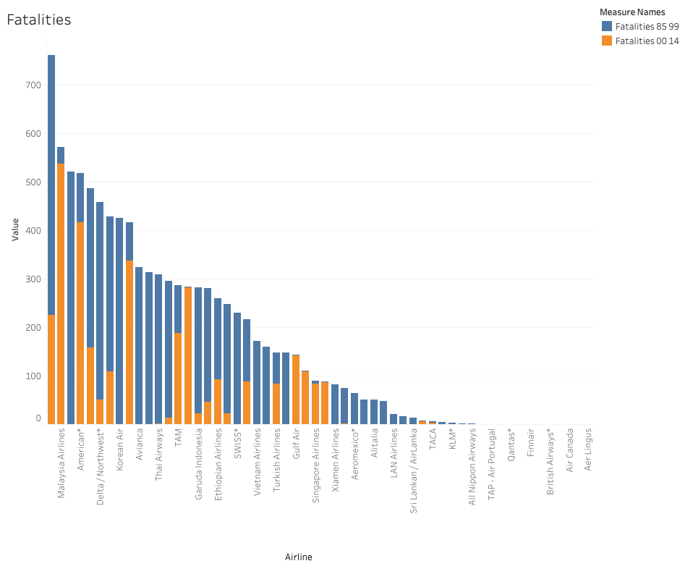
Major Airline Fatalities

Slide 8
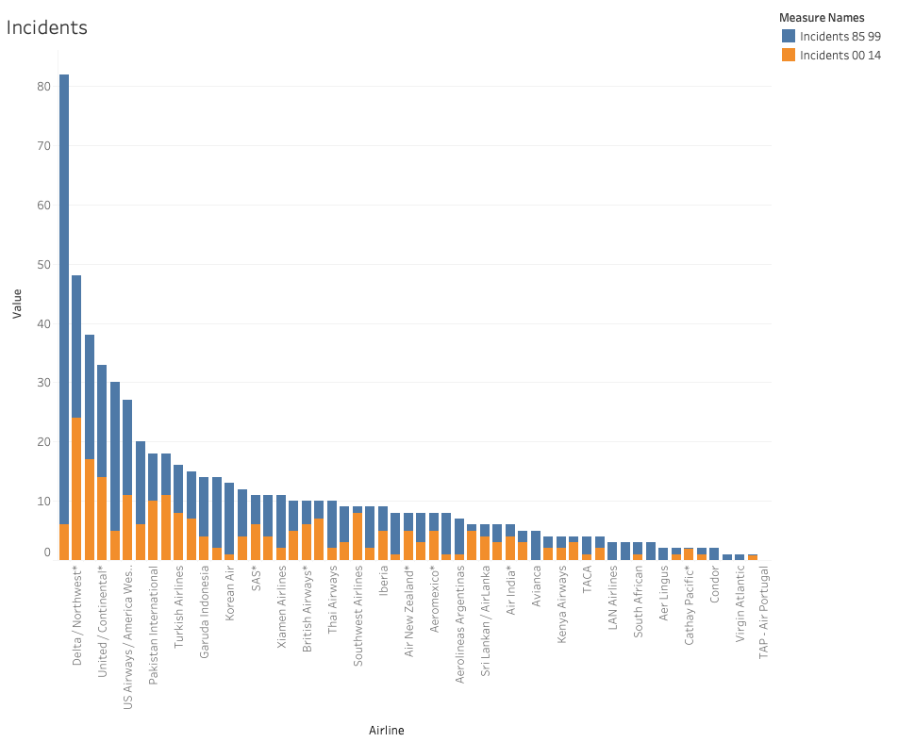
Major Airline Incidents

Slide 9
Conclusion
The financial health of the overall industry is on a positive trend.
Net profits above zero for the past ten years.
Operating Revenue exceeds the overall operating expense.
US Average Domestic Round Trip Airfare has been increasing.
Airline travel is still a safe way to travel
Overall Major Airlines have decreased the number of fatalities over the past 30 years.
Major Airline Incidents have decreased over the past 15 years.

